Slide 1
H1B DATA EXPLORATION
Big Data Engineering Systems Final Class Project

Slide 2
SUNDAYS
The Crew
Hongwei Hu
Byron Kiriibwa
Guangnan Liang

Slide 3
The Dataset
The data was provided by The Office of Foreign Labor Certification
Data size is 700MB (Approximately 3 million Applicants)
Exploration of a sample of the dataset revealed the following features:
CASE_STATUS: Valid values include “Certified,” “Certified-Withdrawn,” Denied,” and “Withdrawn”.
EMPLOYER_NAME: Name of employer
SOC_NAME: SOC_CODE is the occupational code associated with the job being requested for temporary labor condition
JOB_TITLE: Title of the job
FULL_TIME_POSITION: Y = Full Time Position; N = Part Time Position
PREVAILING_WAGE: Prevailing Wage for the job being requested for temporary labor condition.
YEAR: Year in which the H-1B visa petition was filed
WORKSITE: City and State information of the foreign worker's intended area of employment
Geographical location Coordinates of Work site

Slide 4
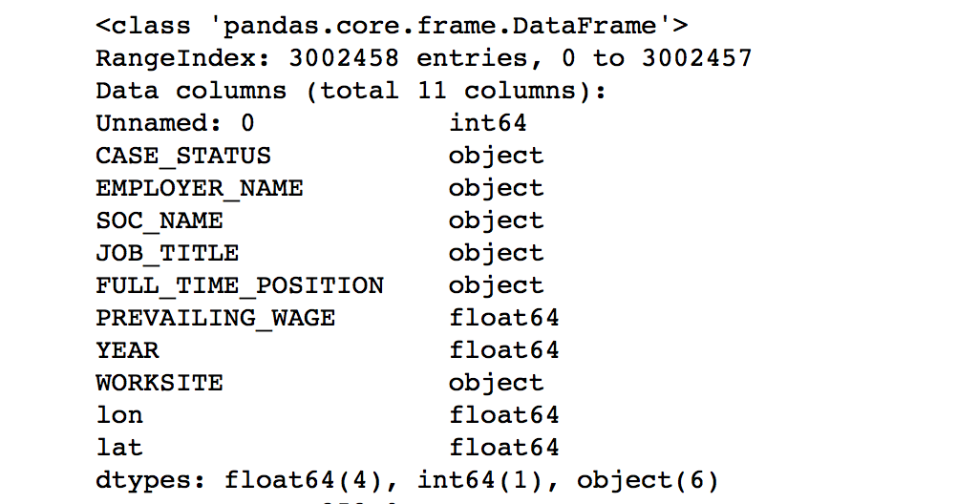

Slide 5
PROJECT OBJECTIVE
The two main objectives of the project were:
To use machine learning techniques to design a model aimed at predicting the case status of any given applicant, given the input data.
To use big data tools to explore the dataset to determine which employers had the highest certification rates.

Slide 6
Key Definitions
Machine Learning
Hyperparameters
Deep learning
MapReduce
Spark
AWS

Slide 7
METHODOLOGY
Process the original dataset to produce an input file
Generate different hyperparameter combinations using Java
Design a deep learning Artificial Neural Network to predict the case status
Use Hadoop, Spark, DeepLearning4j along with hyper parameters from step 2 to create parallel clusters and predict accuracy
Use MapReduce to collect outputs from the multiple clusters and rank the accuracy rates

Slide 8
METHODOLOGY
Using MapReduce
Used MapReduce to rank the employers with highest certified rates
This would produce a list of employers(more than 350 applicants to be ranked) with the highest probability of being certified

Slide 9
BIG DATA TECHNOLOGIES USED
Deeplearning4j Framework
Hadoop MapReduce
Spark
AWS EMR Clusters
S3 – For cluster data storage
GitHub
DropBox
Java

Slide 10
PRACTICAL WORK DONE

Slide 11
Case Status Prediction
A deep learning artificial neural network was designed using deeplearning4j
Using java code, we generated multiple combinations of hyper parameters
We set up automatic parallel EMR Spark clusters on AWS and trained the ANN in parallel, with different hyper parameters per cluster
Results were saved in a bucket on S3

Slide 12
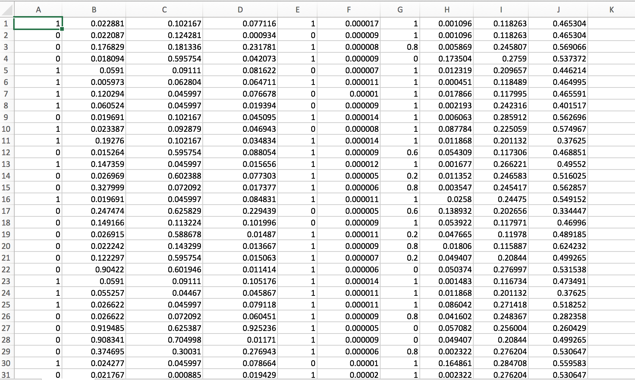
Example of Processed Dataset

Slide 13
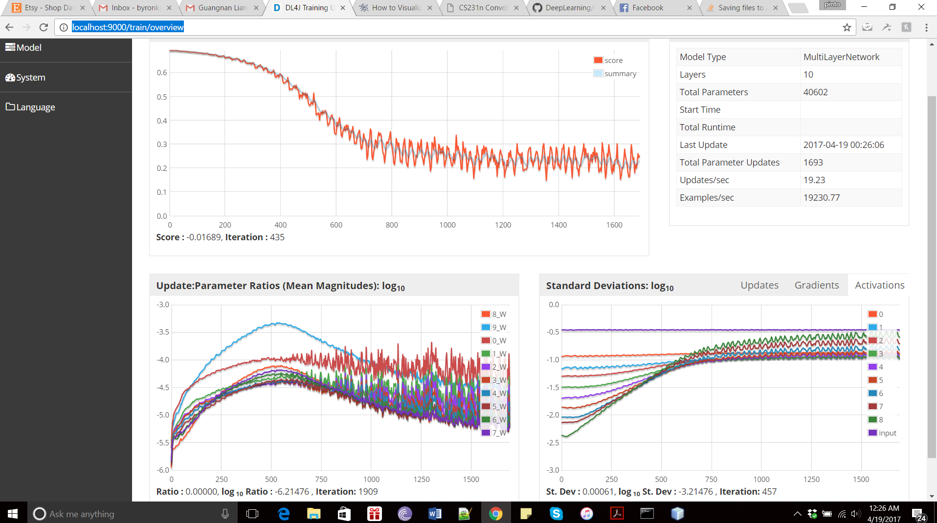
Local Training

Slide 14
ANN Configuration
Hyperparameters
Learning Rate: size of the adjustments made to the weights with each iteration
Batch size:
Number of Epochs
Momentum
ANN Structure
Number of Hidden Nodes
Number of Hidden layers

Slide 15
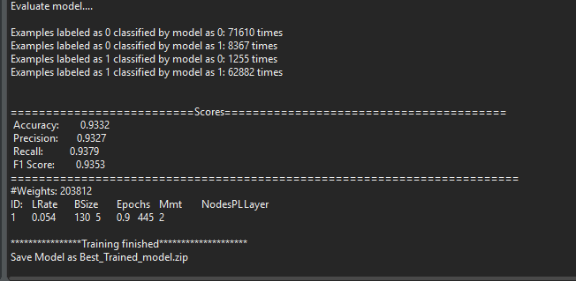
Best Training Model

Slide 16
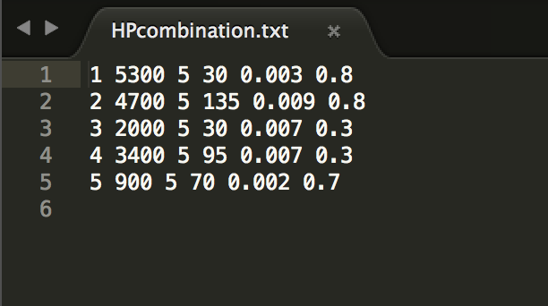
Hyper Parameter Combinations

Slide 17
Parallel Training
ANN Training on Spark:
Build the project, upload the jar to S3.
MR: Create clusters in parallel. (No output)
Each cluster will use the jar in S3 to run a Spark job.
All data will be uploaded to S3

Slide 18
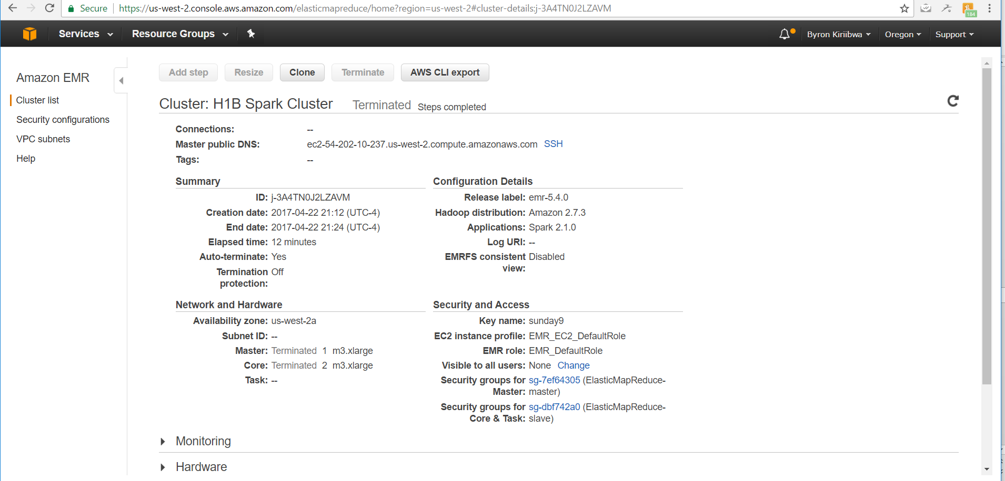
Spark Cluster Configuration

Slide 19
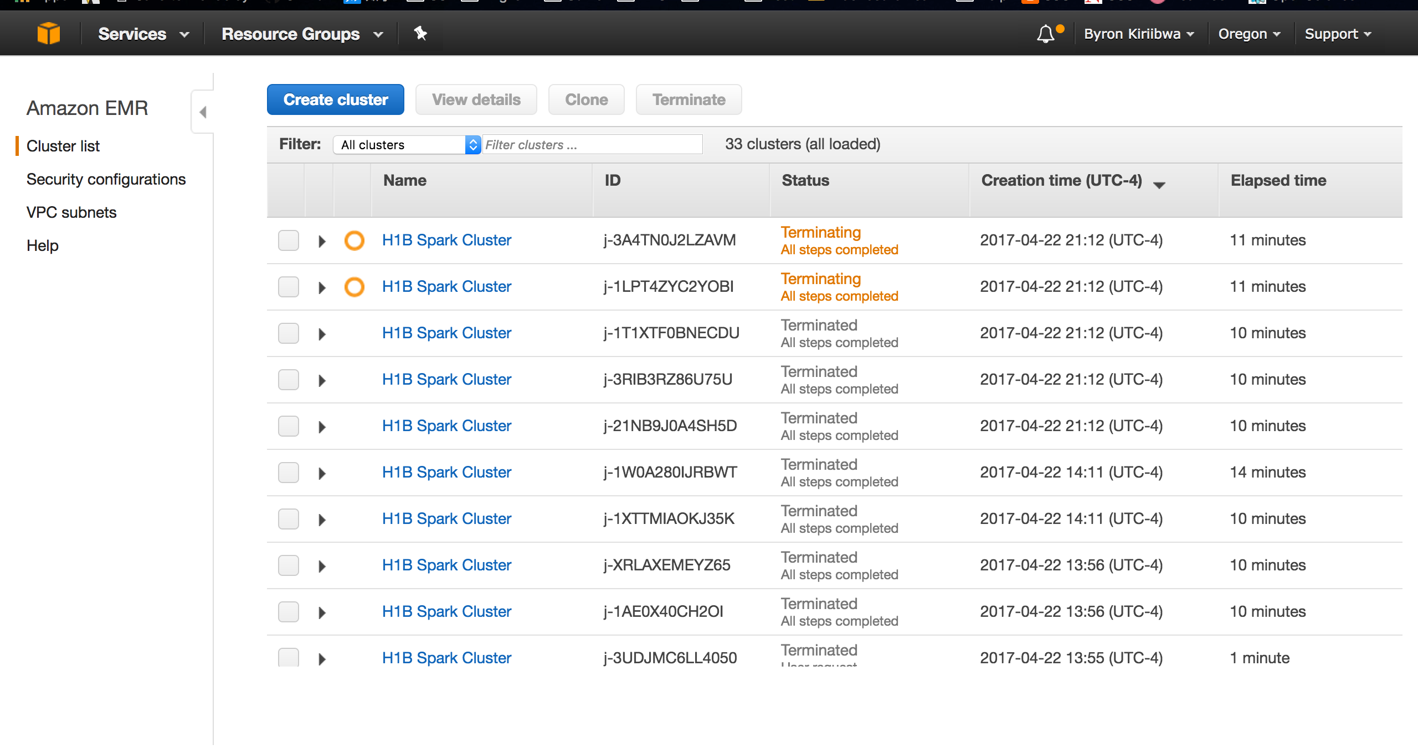
Spark Cluster Configuration

Slide 20
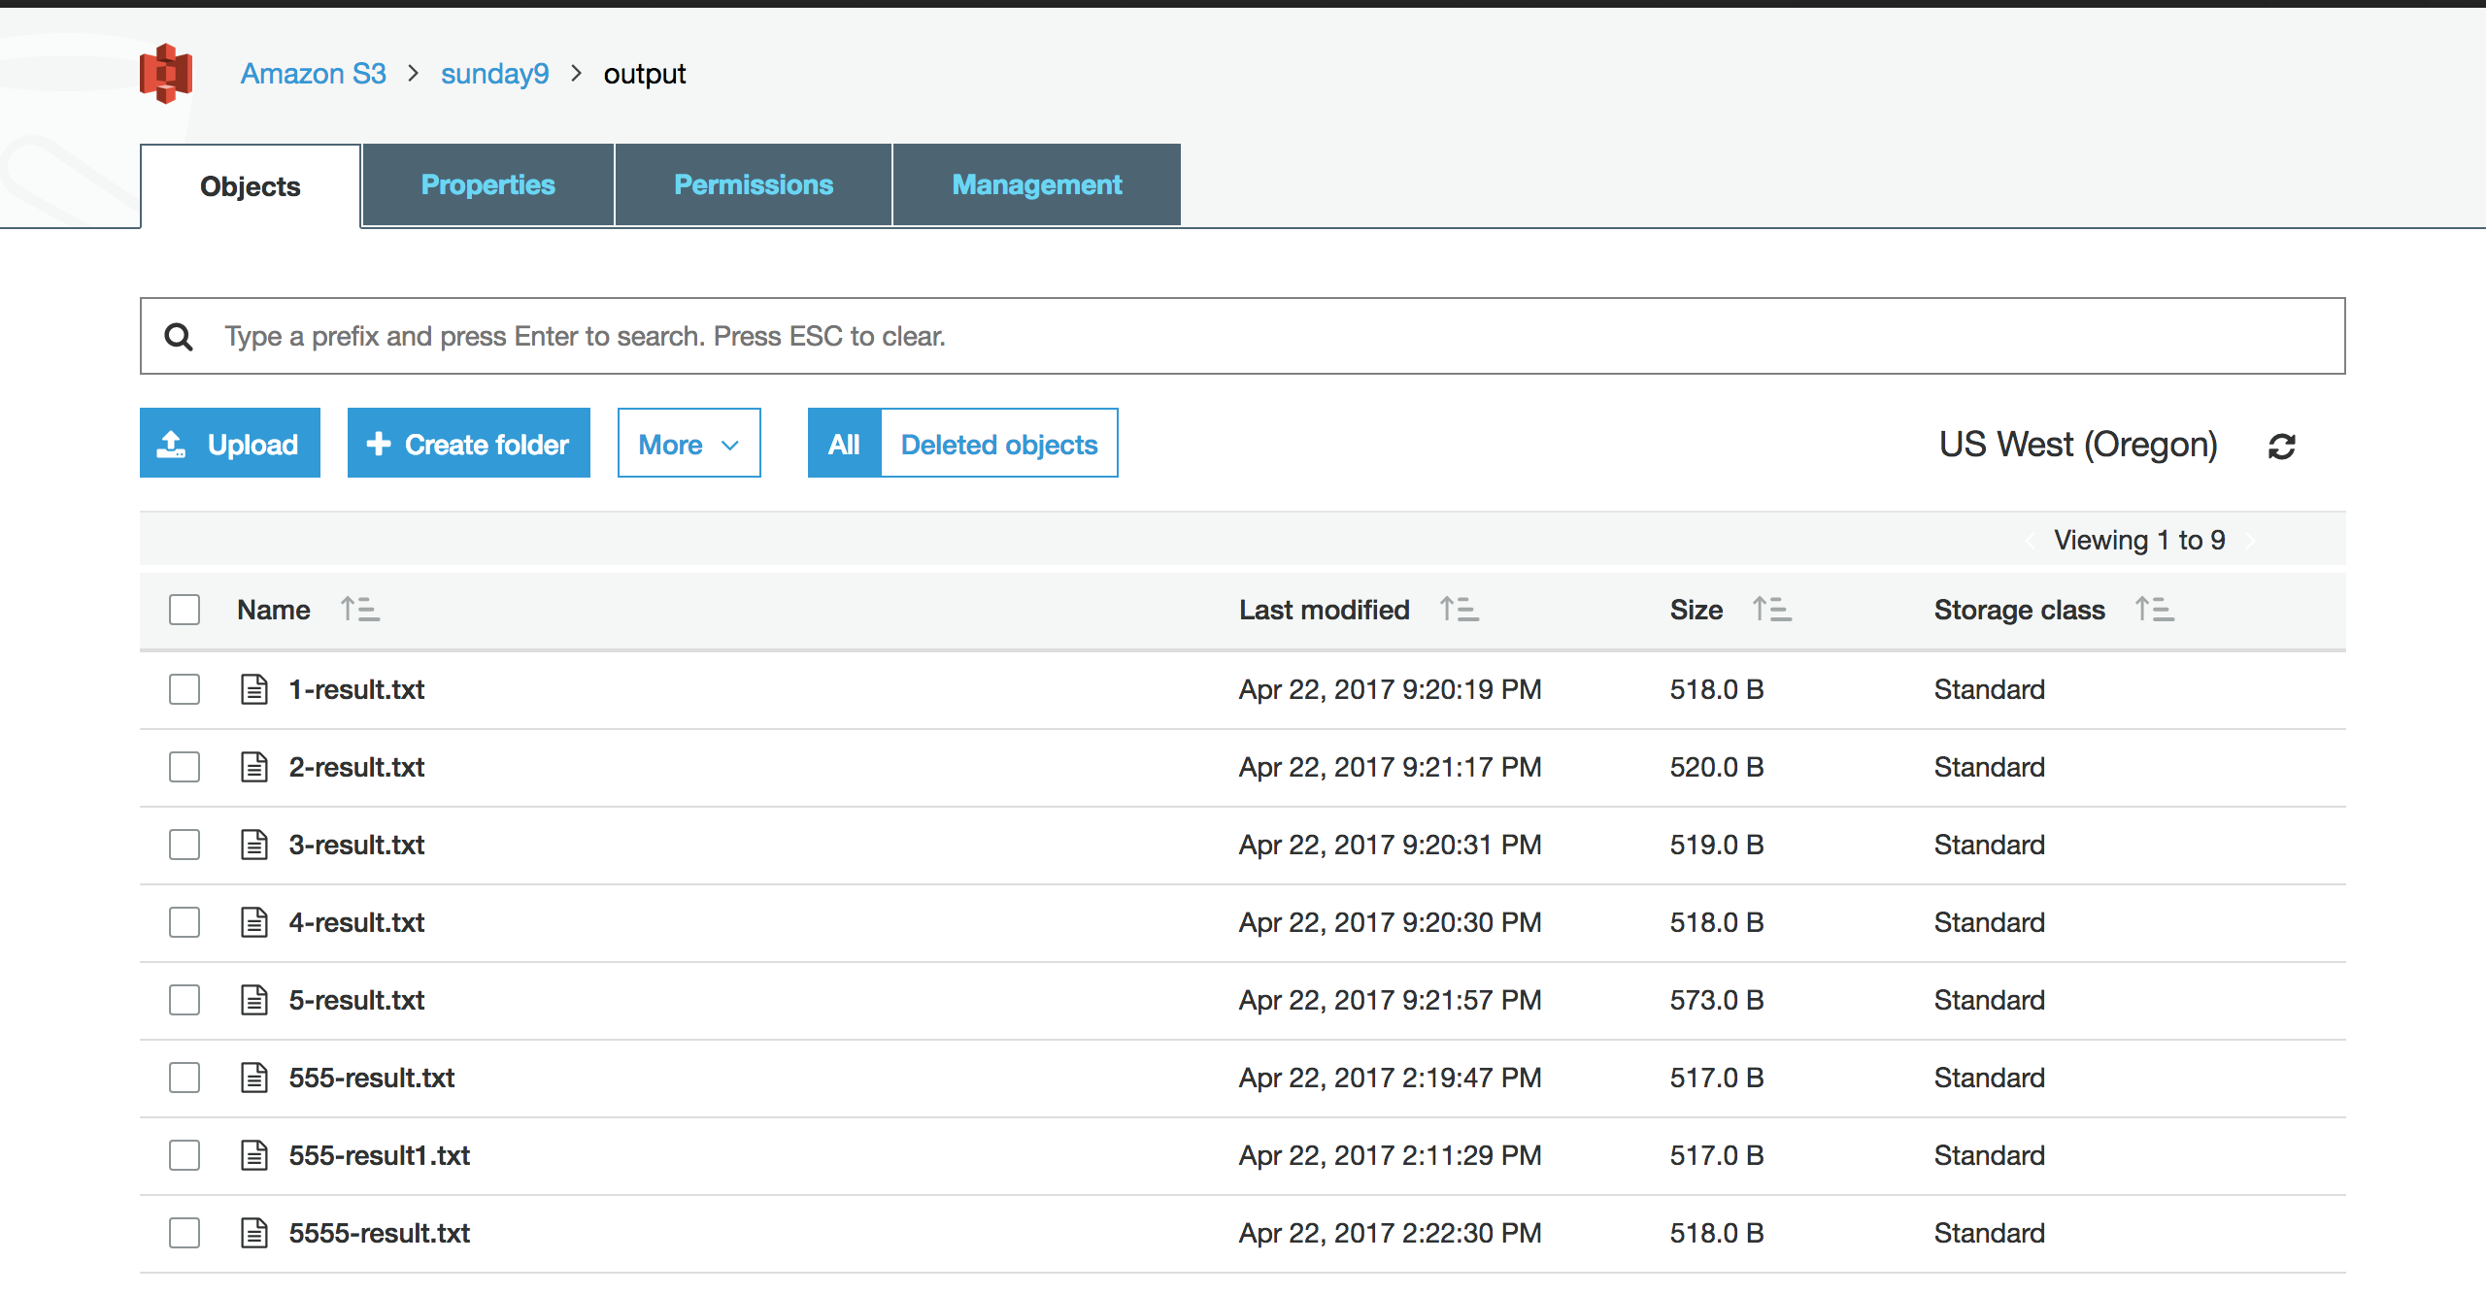
Results from Spark Cluster Execution

Slide 21
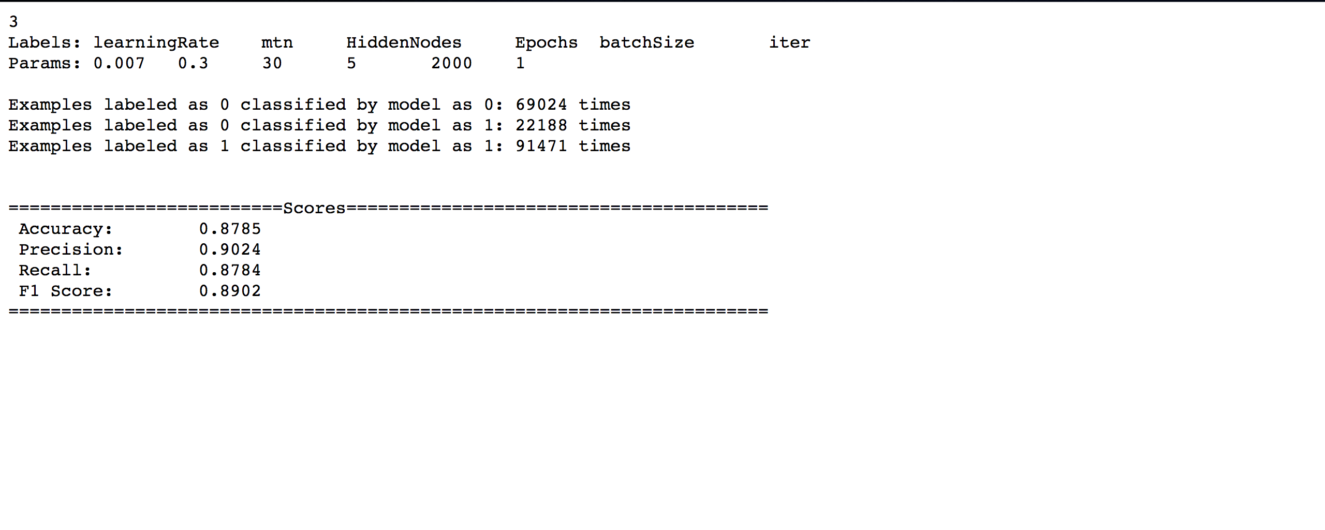
Example of Spark Cluster Output

Slide 22
MapReduce

Slide 23
MapReduce was used to generate 3 key results:
MapReduce 1
Create EMR Spark clusters based on different hyperparameter combinations
MapReduce 2
Collect results from Spark outputs and ranked them based on accuracy
MapReduce 3
To rank employers(>350) based on certified rates

Slide 24
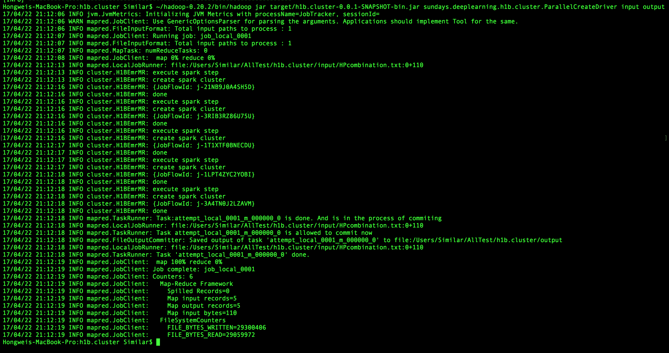
Parallel Spark Cluster Creation

Slide 25
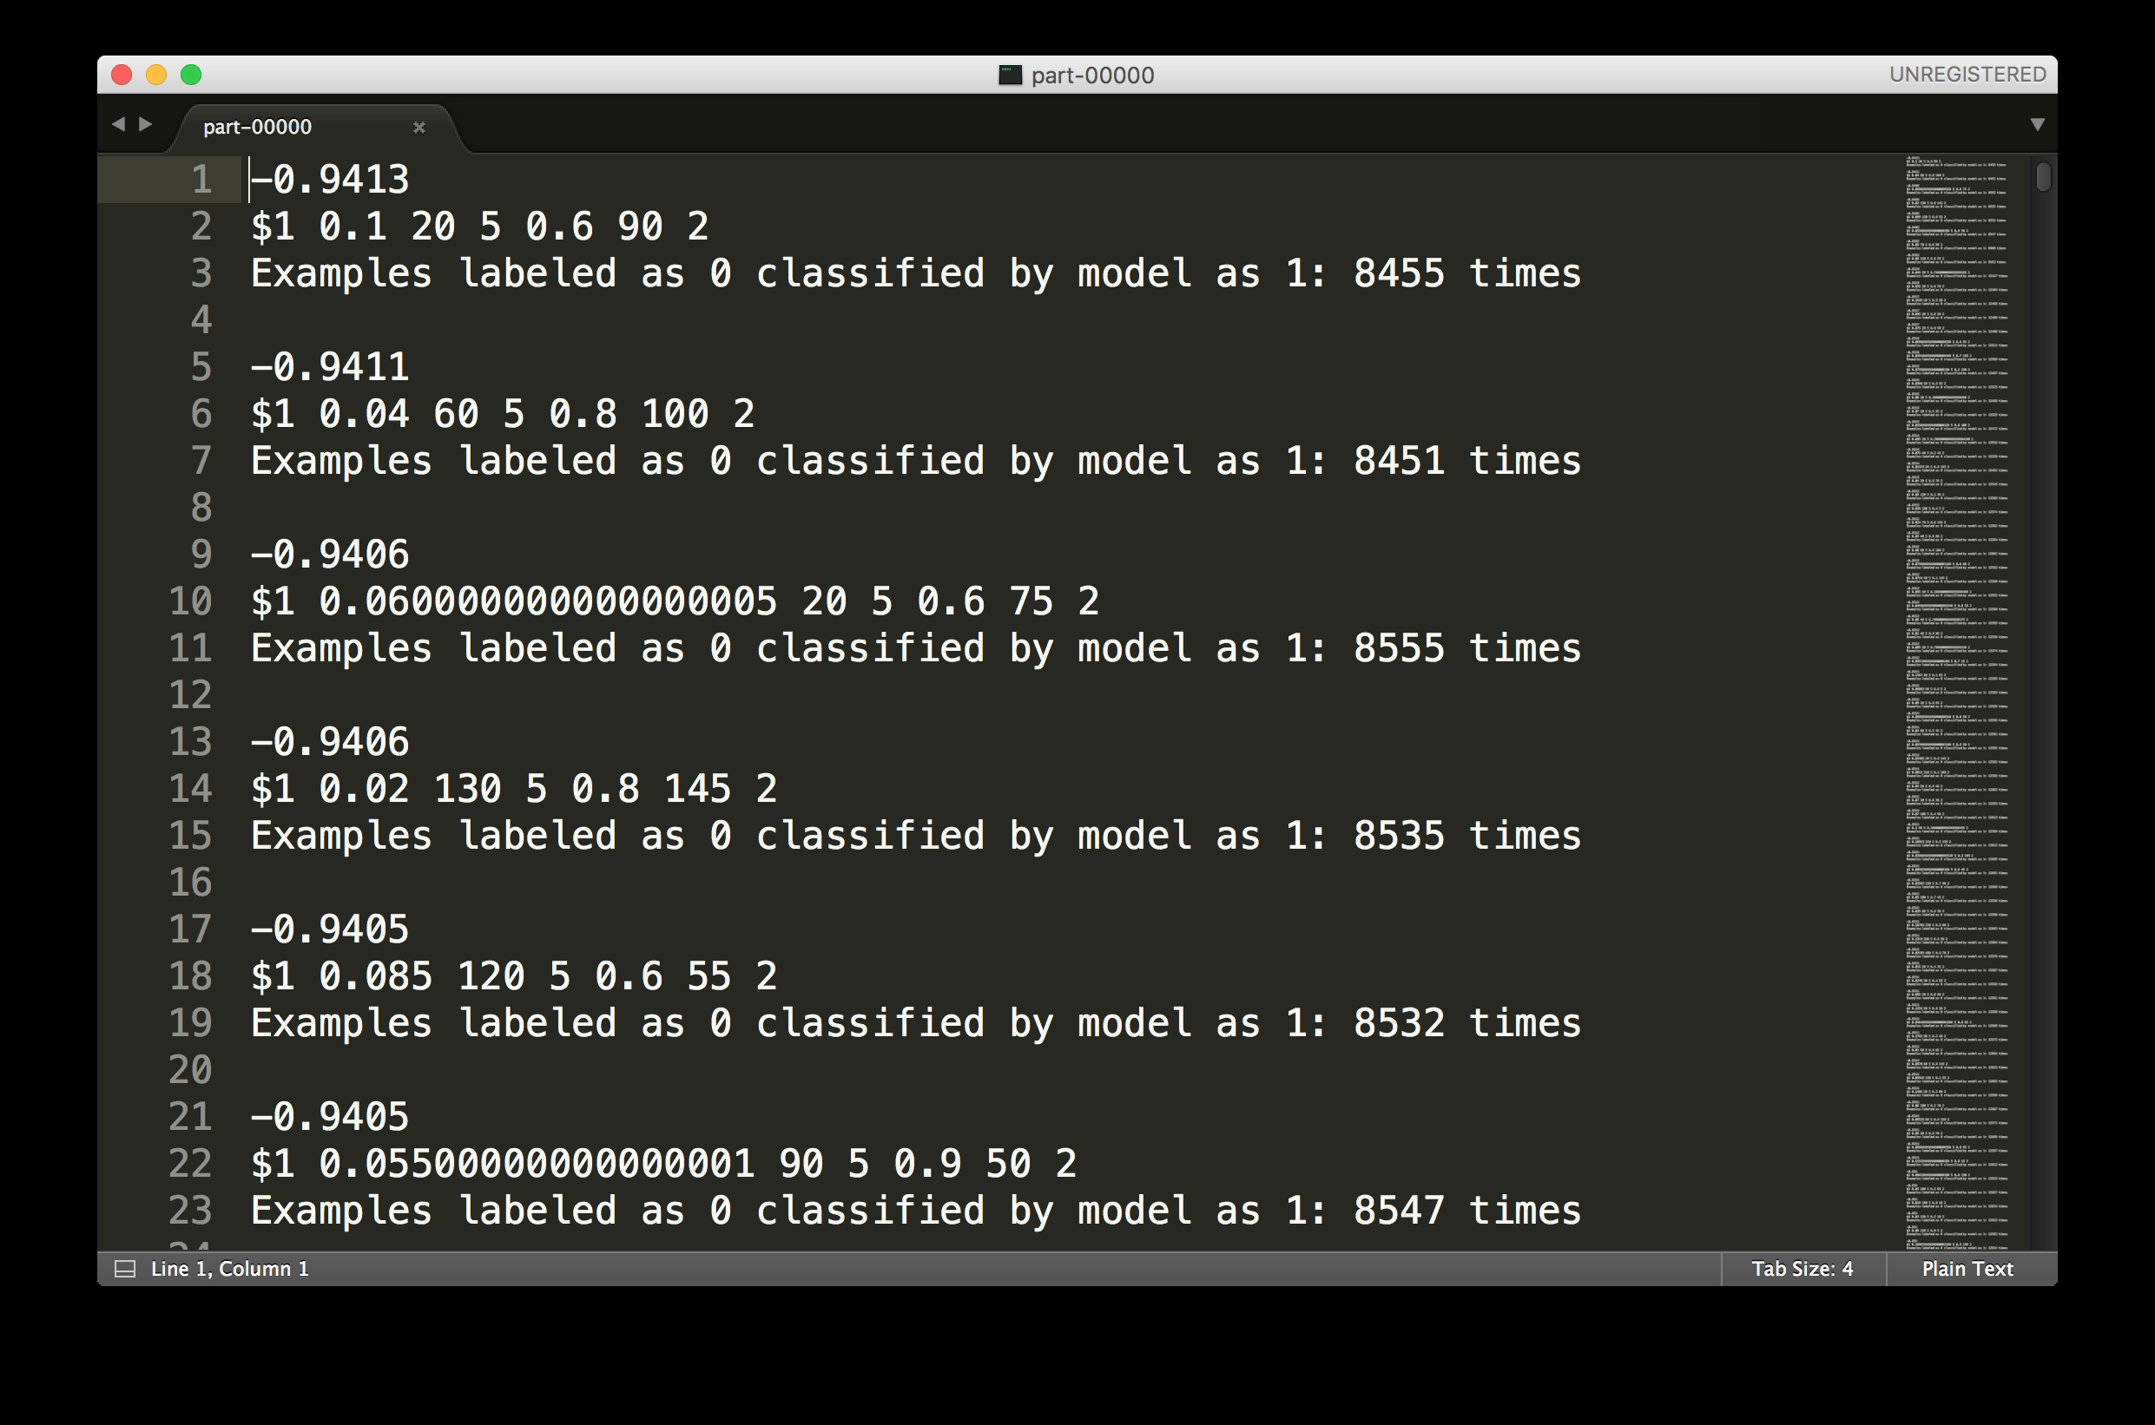
MapReduce 2

Slide 26
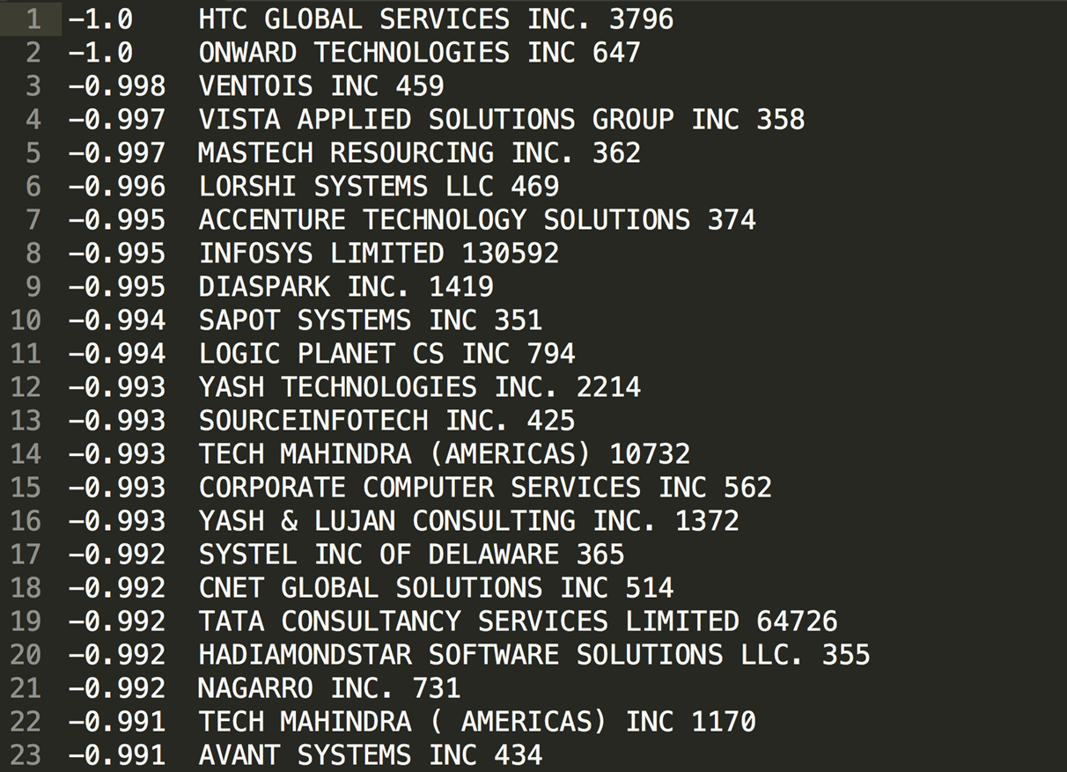
MapReduce 3

Slide 27
Questions

